Slide 1
Python Programming - Lecture 1
Instructor: Muhammad musab

Slide 2
What is Programming?
Programming = Talking to Computers using special languages.
Computers don't understand English or Urdu directly.
We need translators like Compiler/Interpreter.

Slide 3
Practice Assignment 1 – What is Programming?
Write in 1 line: What is programming?
Explain why computers need a translator.
List 3 programming languages.

Slide 4
What is Python?
Simple and Easy to Learn.
Free and Open Source.
High-Level Language (close to English).
Developed by Guido van Rossum.
Used in AI, ML, Web Dev, Automation.

Slide 5
Practice Assignment 2 – What is Python?
List any 3 features of Python.
Who developed Python?
Where can Python be used?

Slide 6
What is Python?
Which one of the following best describes Python’s programming level?
Low-Level Language
Middle-Level Language
High- Level Language
Assembly Language
Correct
c

Slide 7
Installing Python
Download from python.org
Use any IDE like VS Code, PyCharm, Jupyter
Check version using python --version

Slide 8
Practice Assignment 3 – Installing Python
Write steps to install Python.
Name any 2 Python IDEs.

Slide 9
Your First Program
print("Hello World")
`print()` is a function to show output.
Whatever is inside quotes will be displayed.

Slide 10
Practice Assignment 4 – Your First Program
Write a program that prints your name.
Use print() to display your age.

Slide 11
Python Character Set & Comments
Letters: A-Z, a-z
Digits: 0-9
Special Symbols: +, -, *, / etc.
Single-line comment: # this is a comment
Multi-line: """ your comment """

Slide 12
Practice Assignment 5 – Python Character Set & Comments
Write a comment explaining your code.
Use a special symbol in print().
Write a multi-line comment.

Slide 13
Data Types
int – Whole numbers (5, -3)
float – Decimal numbers (2.5, -1.0)
str – Text ("Hello")
bool – True or False
None – No value

Slide 14
Practice Assignment 7 – Data Types
Create one variable of each data type.
Use type() to print their types.

Slide 15
Variables & Identifiers
Variables store data like name, age, price.
Example: name = "Ali", age = 18
Identifiers: Variable names
Must start with letter/underscore, no symbols
An identifier is the name you give to anything in Python: variables, functions, classes, etc.
"Identifier is just the name; Variable is a name + value stored in memory.“
The name of the variable is an identifier.
All variables are identifiers,
but not all identifiers are variables.

Slide 16
Variables & Idntifiers
What is a correct way to declare a Python variable?
var x = 5
#x = 5
$x = 5
x =5
Correct
d

Slide 17
Practice Assignment 6 – Variables & Identifiers
Create 3 variables with your name, age, city.
Write rules for naming identifiers.

Slide 18
Keywords
Reserved words in Python like: if, else, while, True, False
Cannot be used as variable names

Slide 19
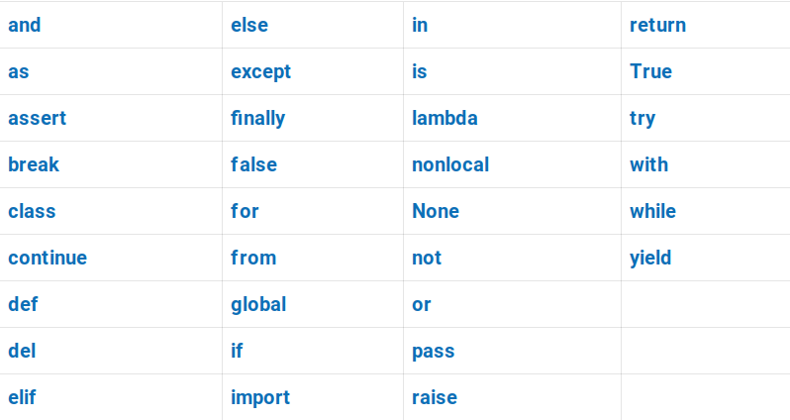
Keywords

Slide 20
Practice Assignment 8 – Keywords
List 5 Python keywords.
Try using `if` as a variable and note the error.

Slide 21
Operators
Arithmetic: +, -, *, /, %, **
Comparison: ==, !=, >, <, >=, <=
Assignment: =, +=, -=, etc.
Logical: and, or, not

Slide 22
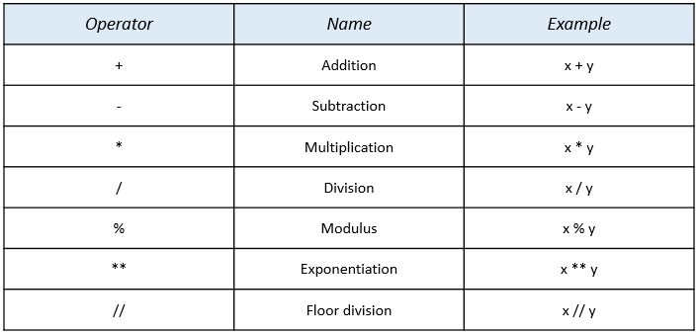
Operators

Slide 23
Practice Assignment 9 – Operators
Write a program using + and % operators.
Compare two numbers using > and ==.

Slide 24
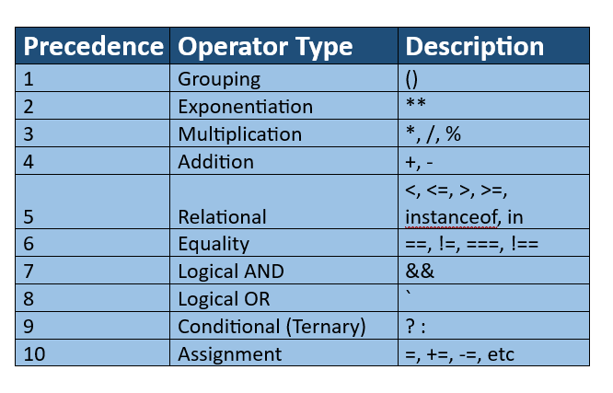
Operators - Precedencse

Slide 25
Univariate vs Bivariate Operators
Univariate: works with one value (e.g., -a)
Bivariate: works with two values (e.g., a + b)

Slide 26
Practice Assignment 10 – Univariate vs Bivariate Operators
Give one example each of univariate and bivariate operators.
Write a program using both.

Slide 27
Input in Python
input() – Takes input as string.
int(input()), float(input()) – Convert input to number.
Example: age = int(input("Enter age: "))

Slide 28
Practice Assignment 11 – Input in Python
Write a program to input your age.
Take 2 numbers from user and print their sum.

Slide 29
Type Conversion vs Type Casting
Conversion: Python auto converts int + float = float
Casting: Manual using int(), str(), float(), etc.
Use when data needs forced type change.

Slide 30
Practice Assignment 12 – Type Conversion vs Type Casting
Use int(), str() and float() on sample values.
Try adding '2' + 3 and fix using type casting.

